Slide 1

Descriptive Statistics and Graphs
Briefs and comments

Slide 2
Summarize Data by Numbers
Quantitative Variables
Mean and Median (Center of a Distribution)
Standard Deviation and Quartiles with Extremes (Spread of a Distribution)
Percentiles (If you need a more thorough examination of a distribution)
Categorical Variables
Frequency and Relative Frequency

Slide 3
Remarks
Mean and standard deviation are arithmetic-based statistics.
Mean and standard deviation are often used to summarize symmetric distributions.
Mean and standard deviation are often used in parametric methods.
Median, quartiles, and extremes are location-based (rank-based) statistics.
Median and quartiles are often used to summarize asymmetric distributions.
Median is often used in non-parametric methods.

Slide 4
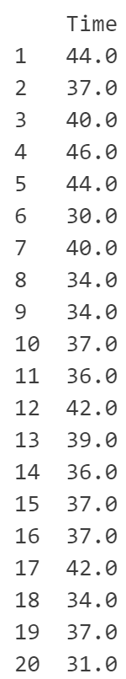
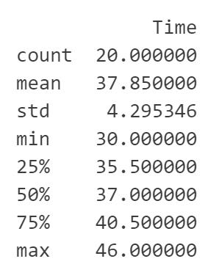
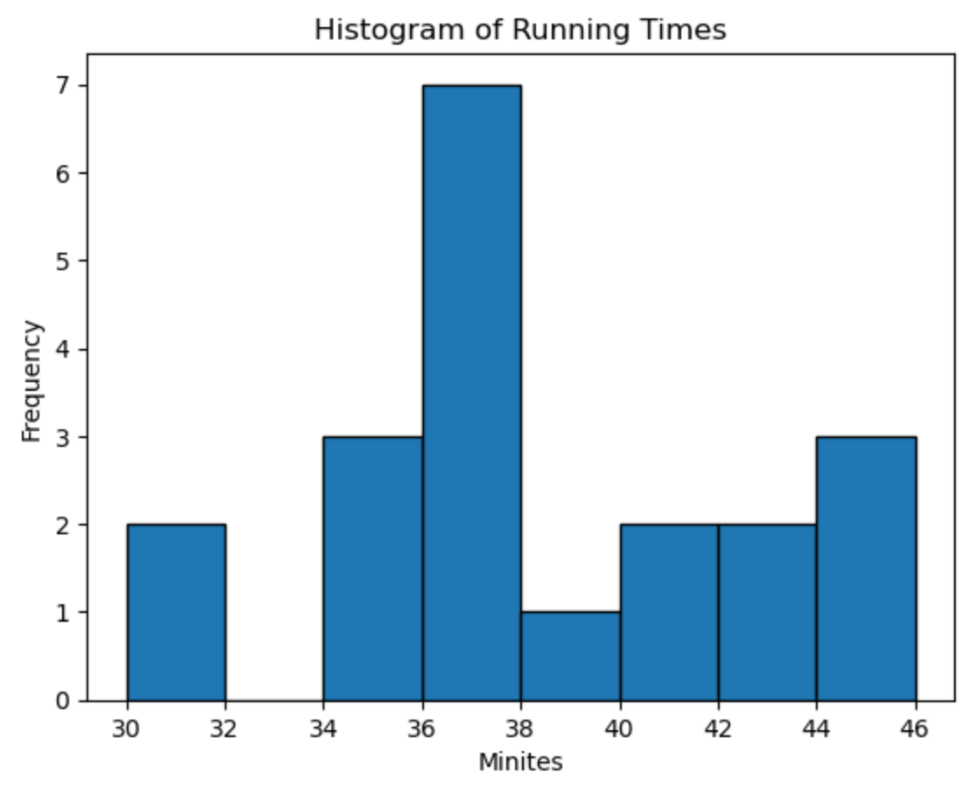
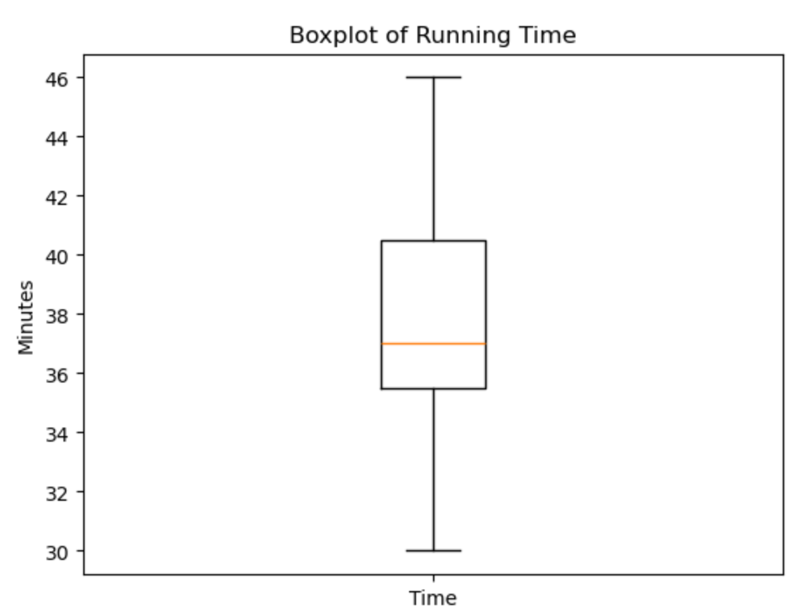
Example: 5K Race

Slide 5
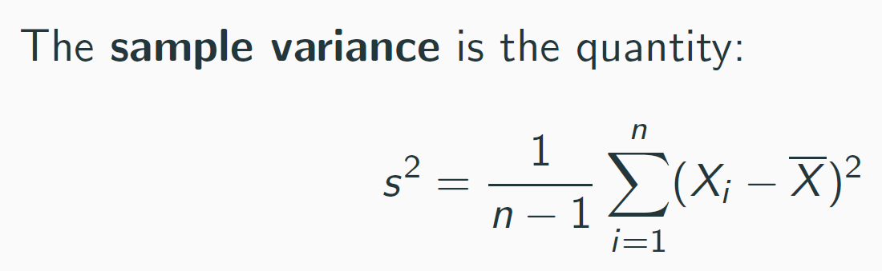
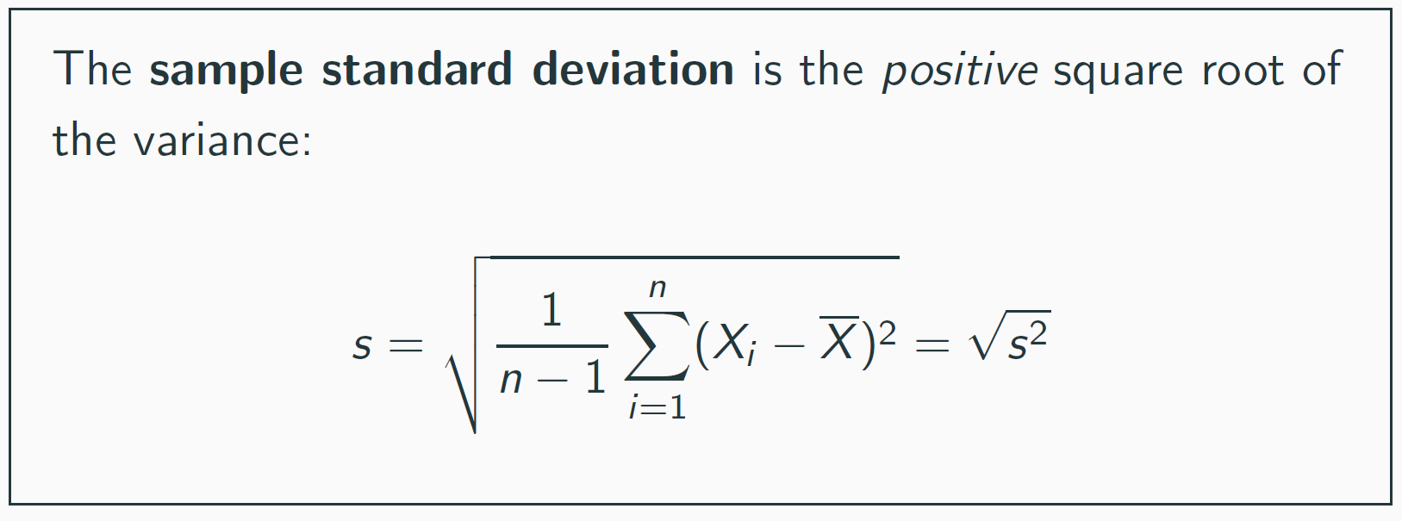
Sample Standard Deviation

Slide 6
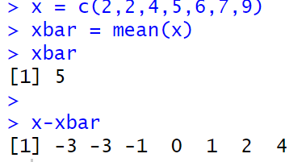
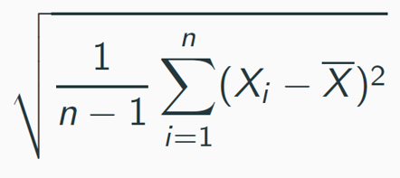

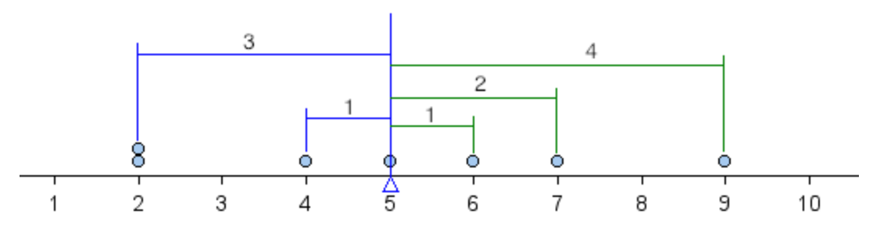
Understand Standard Deviation
https://pressbooks.cuny.edu/conceptsinstatistics/chapter/standard-deviation-1-of-4-concepts-in-statistics/

Slide 7
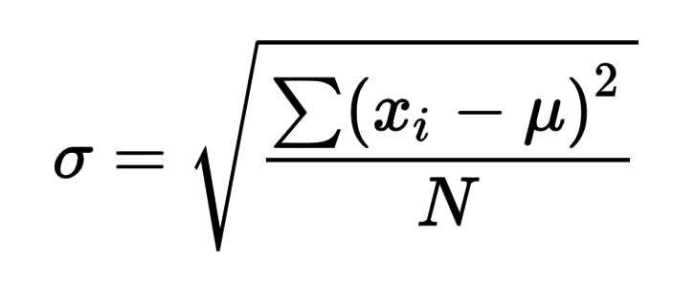
Remarks
The sample standard deviation provides an assessment of roughly the average deviation from observed values to the mean (center of the distribution).
The population standard deviation has a slightly different formula.
The sample standard deviation is an unbiased estimate of the population standard deviation if the sample represents the population.

Slide 8
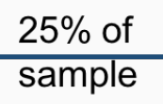
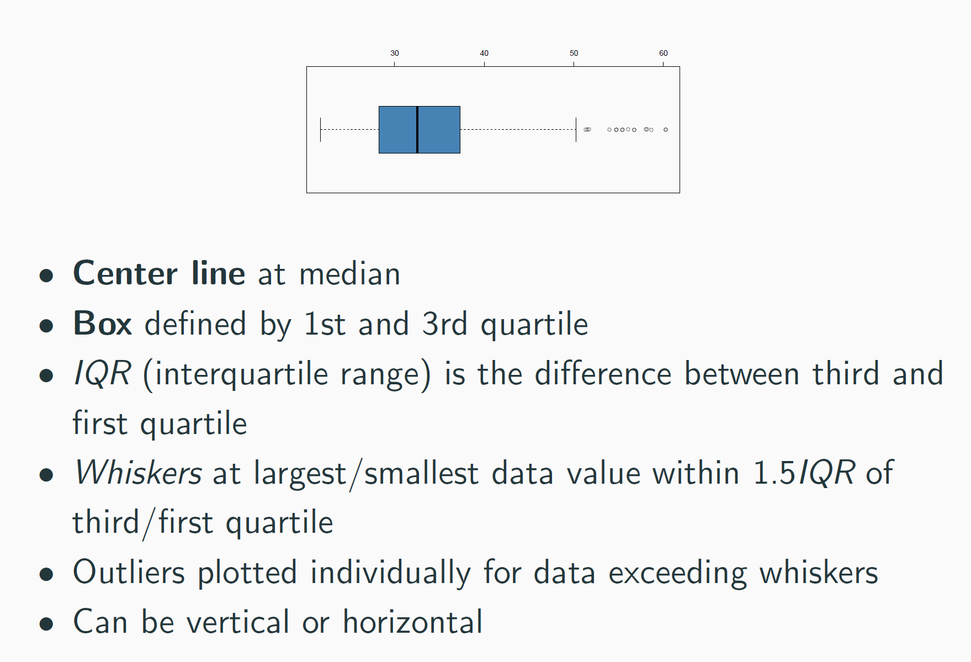
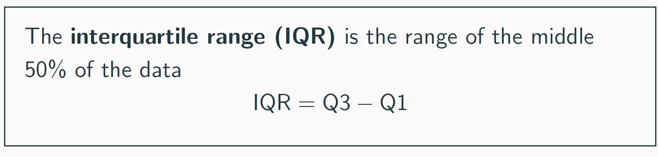
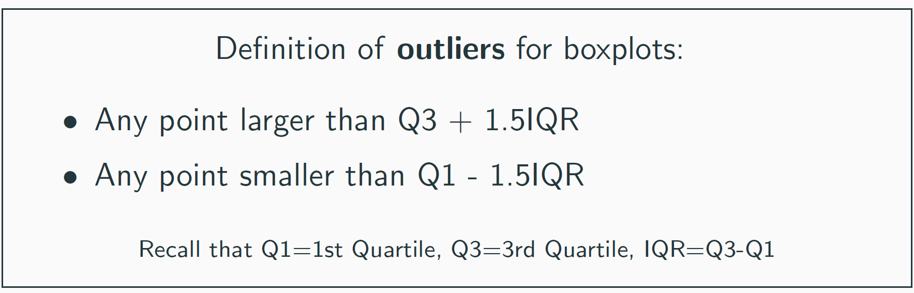
Making a Boxplot

Slide 9
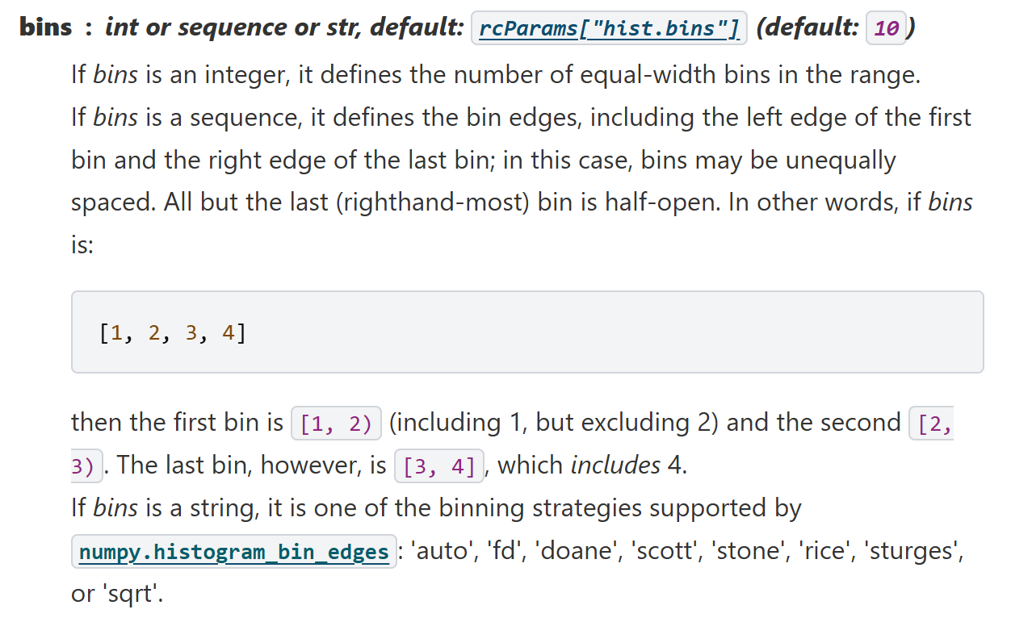
Making a Histogram
Python
R

Slide 10
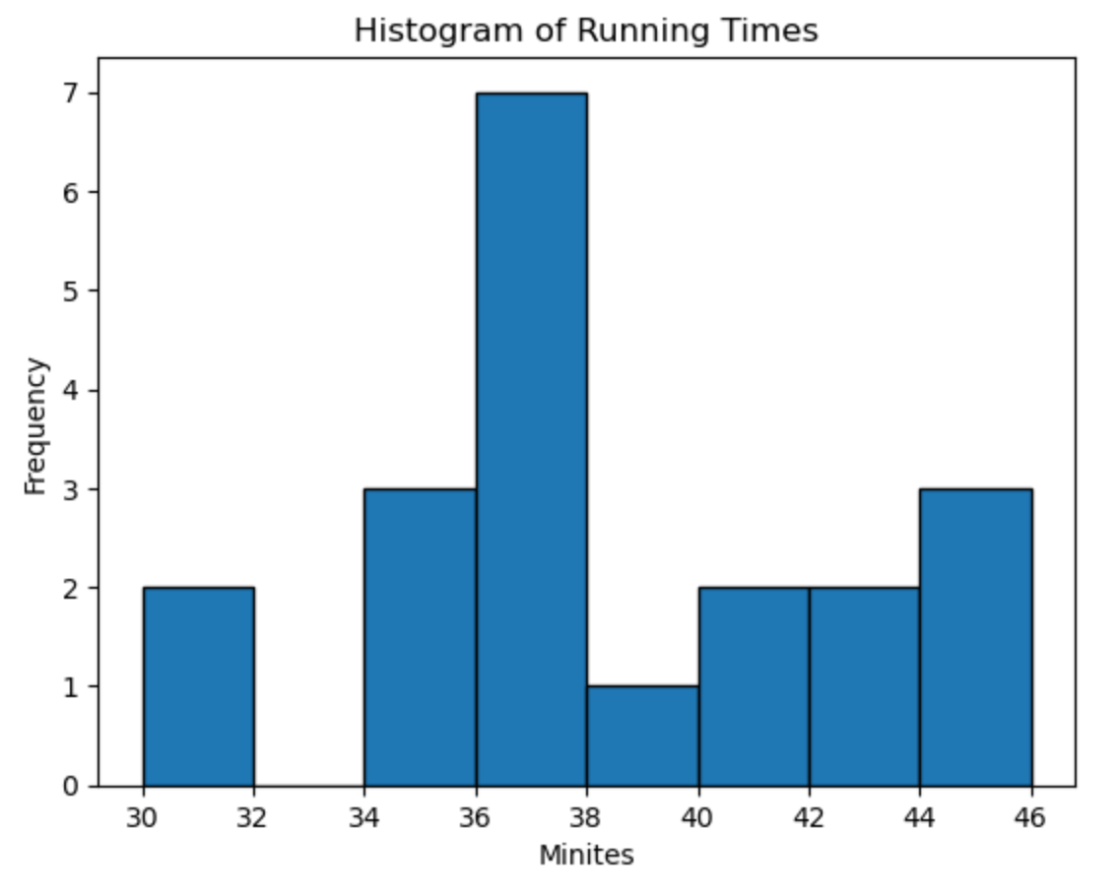
Additional Note for Doing HW
I know it might sound confusing, but let’s pretend for a moment that we don’t know the actual values of running times; what we have is only the histogram.
Q1 occurs around 36.
Median occurs in the interval [36, 38).
Q3 occurs around 42.
The bins here are [30,32), [32,34), [34,36), [36,38), [38,40), [40,42), [42, 44), [44,46].

Slide 11
Let’s see where the quartiles are

Slide 12
Remarks
Please note that there are several methods to compute the quartiles, specifically the first and third quartiles. For example, the following shows how the argument “type=“ from R in the function quantile() controls the choice of different methods.
https://www.rdocumentation.org/packages/stats/versions/3.6.2/topics/quantile
When calculating the quartiles in Python or R, please use the default setting unless you have a special reason to change it.

Slide 13
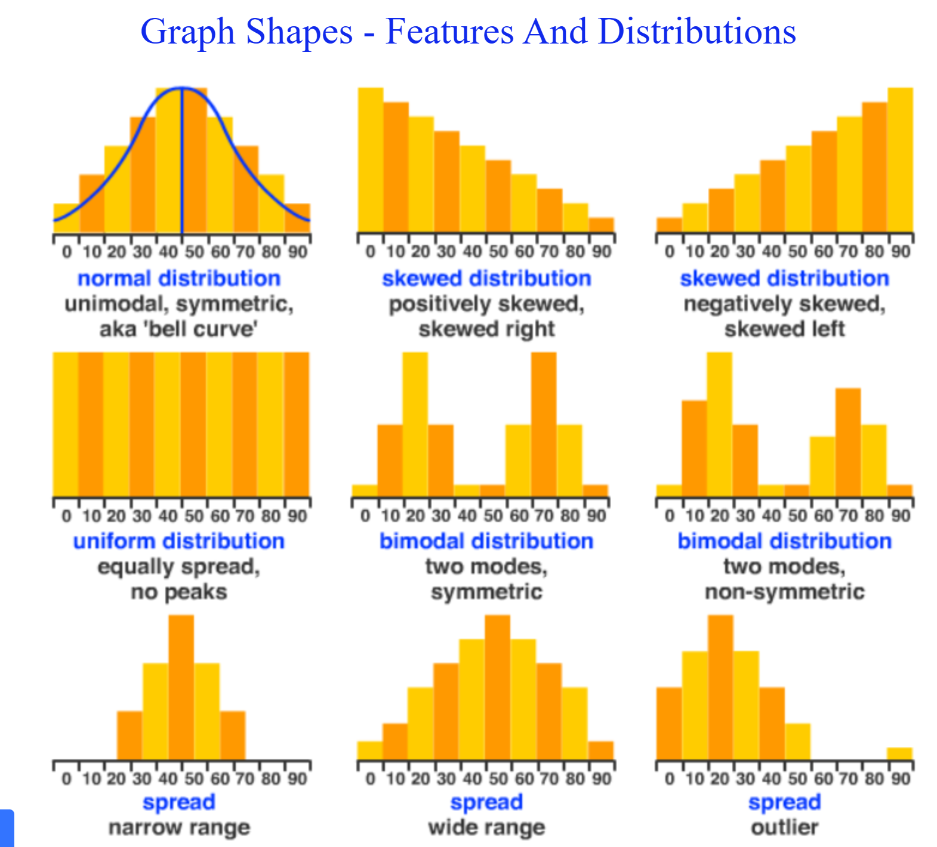
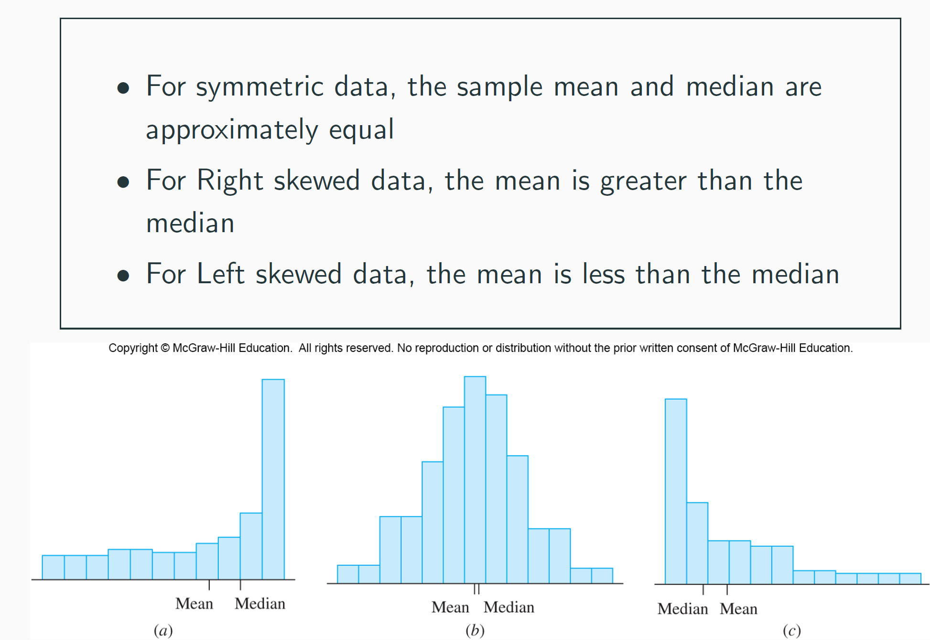
Shapes of Distributions - Histogram
If you want to learn more, you can refer to this post:
https://mathtec.weebly.com/graph-shapes.html
This is not required materials.

Slide 14
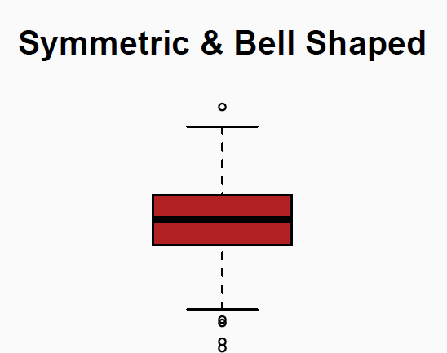
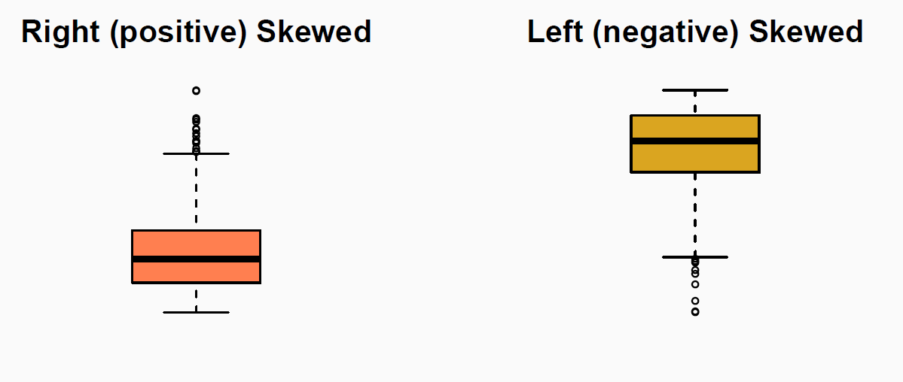
Shapes of Distributions - Boxplot

Slide 15
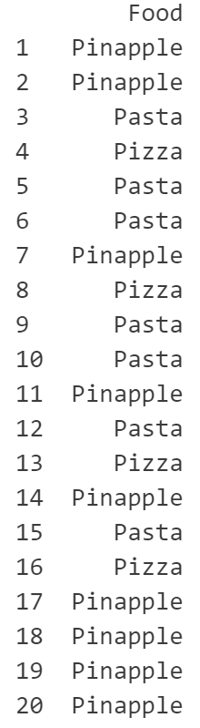
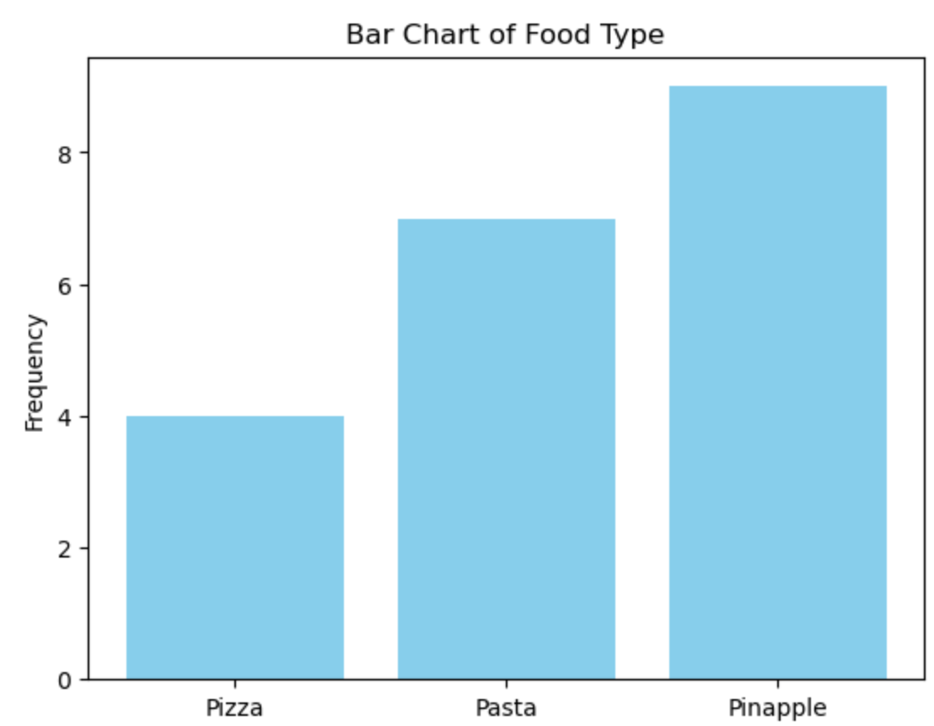
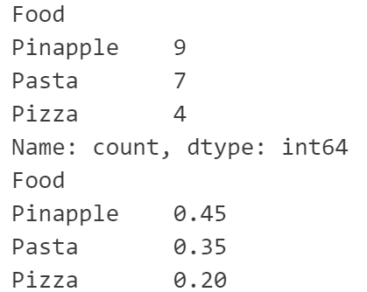
Example: Food Choice After Running

Slide 16
Remarks
You cannot summarise the shape of the distribution of a categorical variable using its bar chart. Because the categories can be rearranged. Then, the overall shape is changed.
The best way to see the pattern from a bar chart is to arrange the bars (categories) using the ascending or descending order of their frequencies or relative frequencies.

Slide 17
Summary
Commonly Used Descriptive Statistics
Commonly Used Graphs.

Slide 18
Quote of the Day
Doctrine and Covenants 45:62
For verily I say unto you, that great things await you;

Slide 19
Typos?
Please email me any typos and errors you found in this lesson.
Thank you!

